Slide 1
Leveraging sentiment analysis for business success
AHMAD HARITH

Slide 2
AGENDA
Scoping the Problem
Identifying the problem statement
Understanding/Cleaning the Data
Performing Exploratory Data Analysis (EDA) on the dataset for clarity
Visualising the Data
Envision the Data into graphs for better clarity
Unsupervised Learning
Teaching the model to find patterns in the data without any given answers
Supervised Learning
Teaching the model using examples with answers
Business Recommendation
Possible solutions to implement

Slide 3

Problem Scoping
What is the problem? (Understanding Sentiments)
Who is affected by it and how? (Key Stakeholders)
What is the value in solving the problem? (Improved Decision-Making)
Why solving the problem matters? (Competitive advantage)

Slide 4

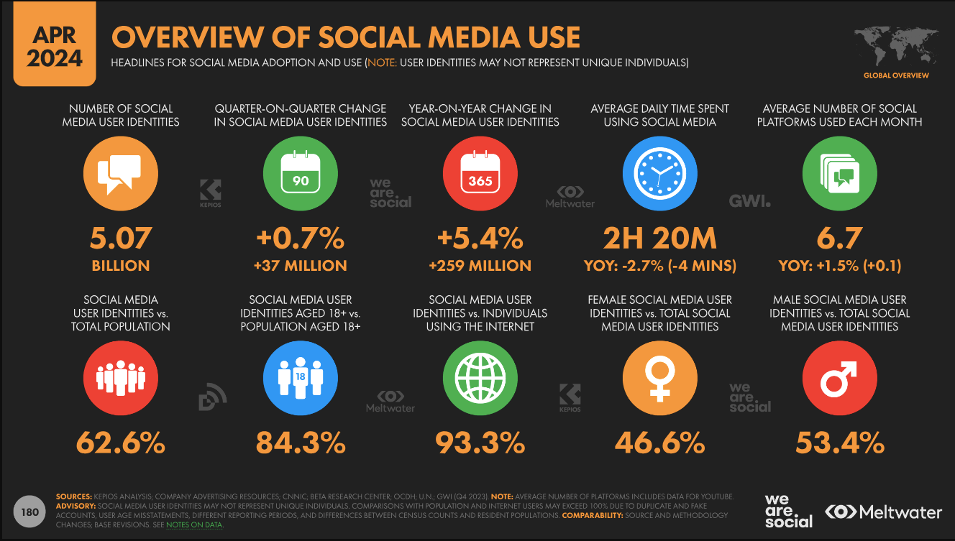
Understanding Sentiment on Social media
Communication Channel for customers and businesses
Most people are on Social Media

Slide 5



AFFECTED PERSONEL
Business Owners
Marketers

Slide 6




In what way?
Business Owners
Marketers
Monitor and manage their brand's reputation by tracking public sentiments
Understand customer sentiments to develop targeted marketing campaign

Slide 7
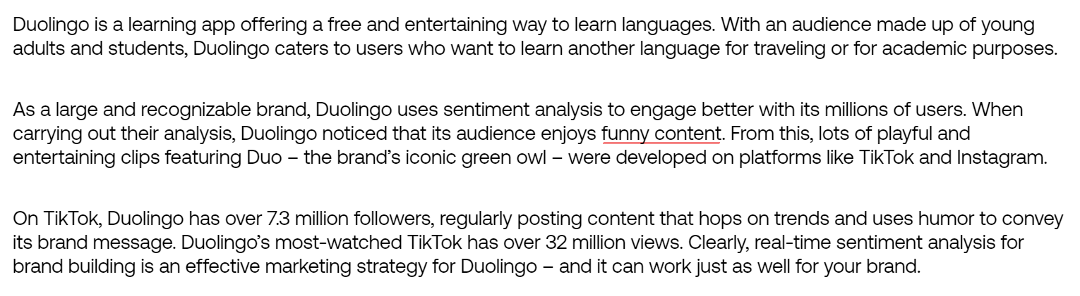
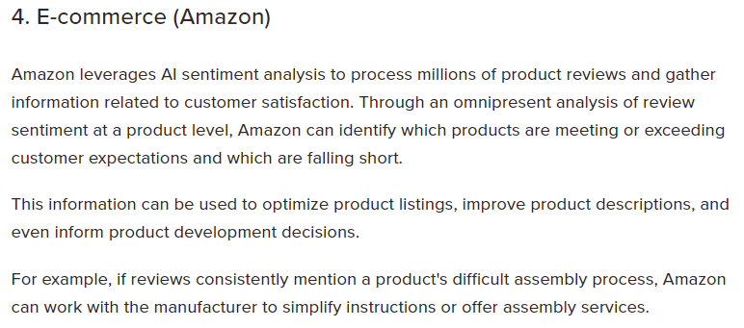

Value in solving?
Business Owners
Marketers
Customer Satisfaction
Resource Allocation
Improved Decision-Making
Source
Source

Slide 8


Why does it matter?
Business Owners
Marketers
Competitive Advantage
Enhanced Communication
Market Adaptation

Slide 9
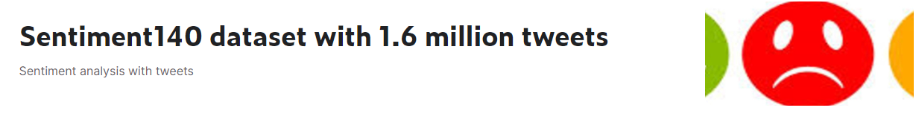
Data sourcing on Kaggle
Source

Slide 10
Understanding the data
Column Names
IDs | Target | Flag
Date | Text | User
There are 1,600,000 rows and 6 columns
Shape = (1600000, 6)
Columns Utilized

Slide 11

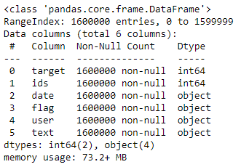
Cleaning the data

Slide 12
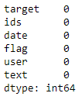
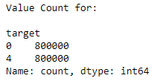
Cleaning the data
There was neither null values nor '?'
Data Set is too large
Computationally Heavy = More Cost

Slide 13
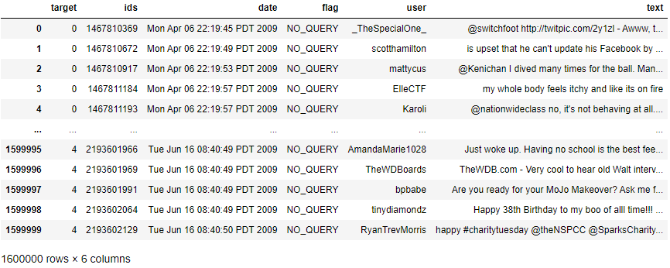

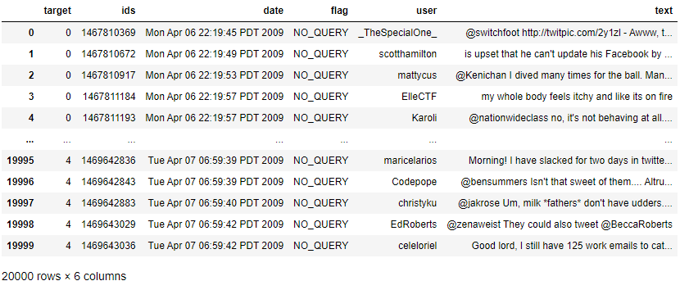

Trimming the data
Reduced dataset from 1,600,000 rows to 20,000
Final Shape = (20000, 6)

Slide 14
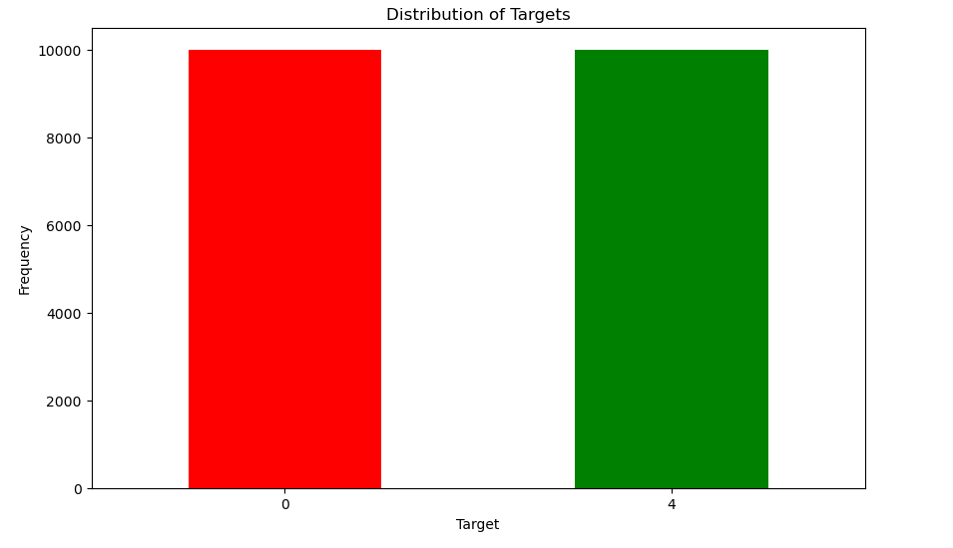


Visualization (Bar Chart)

Slide 15
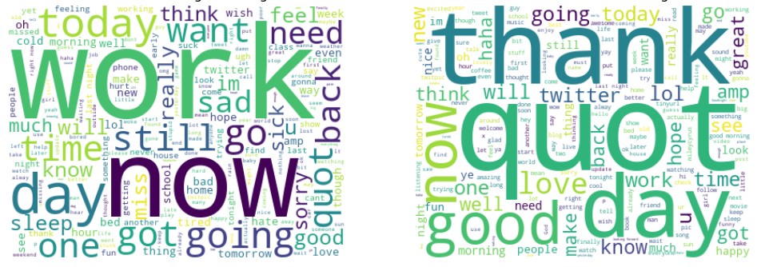
Visualization (Word Clouds)
Negative Sentiments
Positive Sentiments

Slide 16
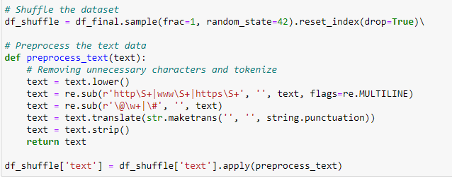
UNSUPERVISED LEARNING
Shuffle the dataset for fairness/random aspect
Preprocess the text

Slide 17
Unsupervised machine learning process
Vectorizing (TF-IDF)
Dimensionality Reduction (PCA)
Vectorizing the text data
vectorizer =
TfidfVectorizer()
max_df=0.75
min_df=2
max_features=500
ngram_range=(1,1)
X_tfidf =
vectorizer.fit_transform(df_shuffle['text'])
Applying PCA
pca =
PCA()
n_components=2
random_state=42
X_pca =
pca.fit_transform(X_tfidf.toarray())

Slide 18
Unsupervised machine learning process
Clustering (K-Means)
Add to DataFrame
Apply K-Means clustering to the PCA Results
kmeans =
KMeans(
max_iter=100
n_clusters=4
random_state=42
clusters =
kmeans.fit_predict(X_pca)
Adding cluster labels to the PCA DataFrame
df_shuffle['Cluster'] = clusters

Slide 19
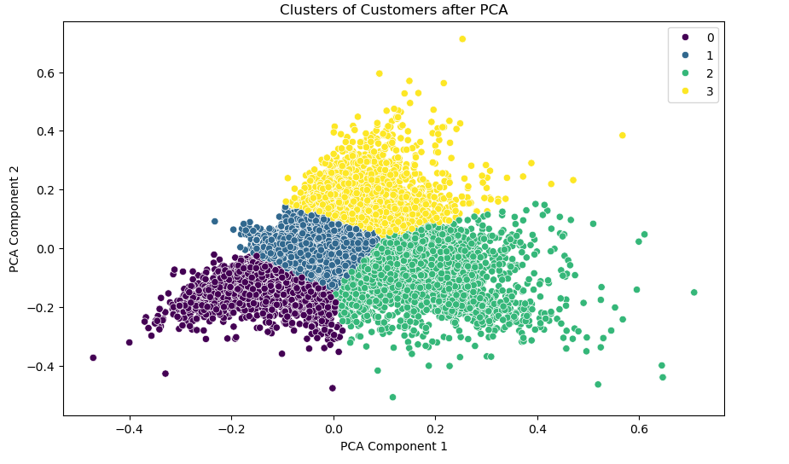
Visualizing the model (Scatterplot)
Densely packed in the lower-left quadrant, indicating specific and distinct customer characteristics.
Spread out at the bottom-center, showing variability within this group
Dense but somewhat spread in the lower-right quadrant, indicating moderate similarity among customers.
Dispersed in the upper part, suggesting high variability within this group.

Slide 20
Supervised model
X (Feature Variable) | Text
Y (Target Variable) | Target

Slide 21
Supervised Machine learning process
Defining a function
Defining Classifiers used
Defined a function to train and evaluate a model's metrics as well as their Receiver Operating Characteristic (ROC)
Metrics include:
Accuracy
Precision
F1
Recall
Confusion Matrix
Logistic Regression
Support Vector Machine (SVM)
Random Forest
Gradient Boosting
Naive Bayes

Slide 22
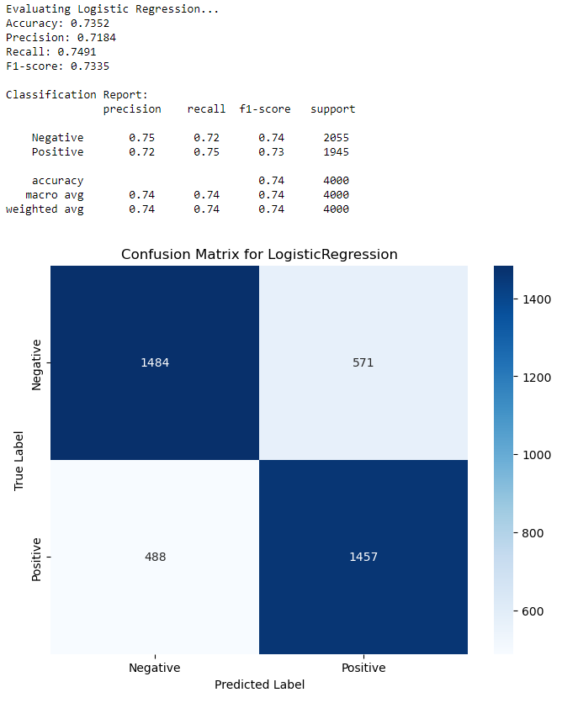
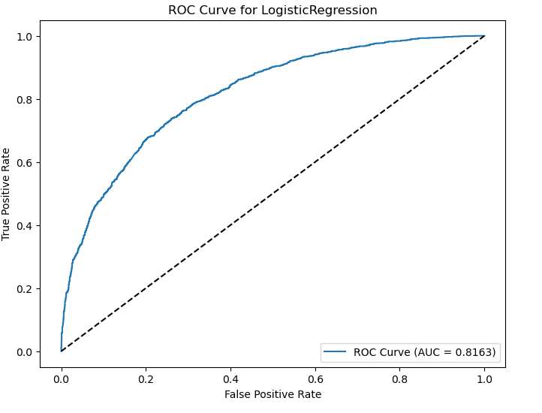
Logistic Regression Model

Slide 23

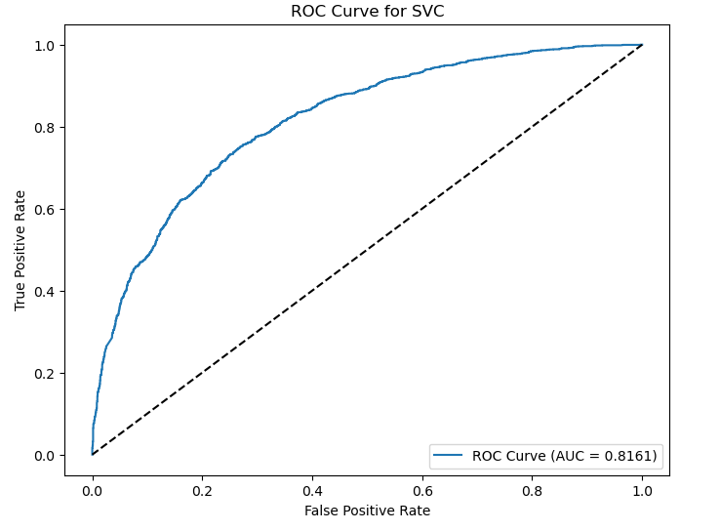
Support Vector MACHINE

Slide 24
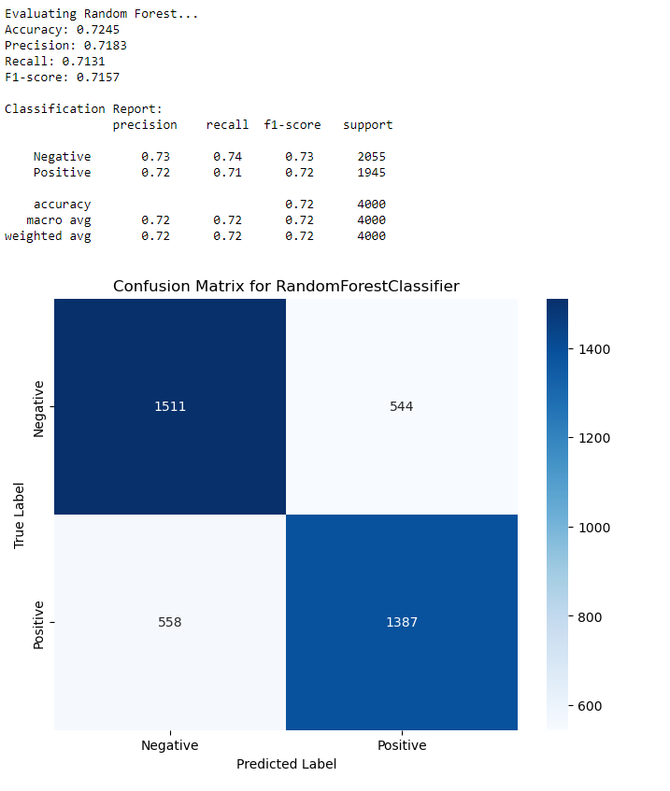
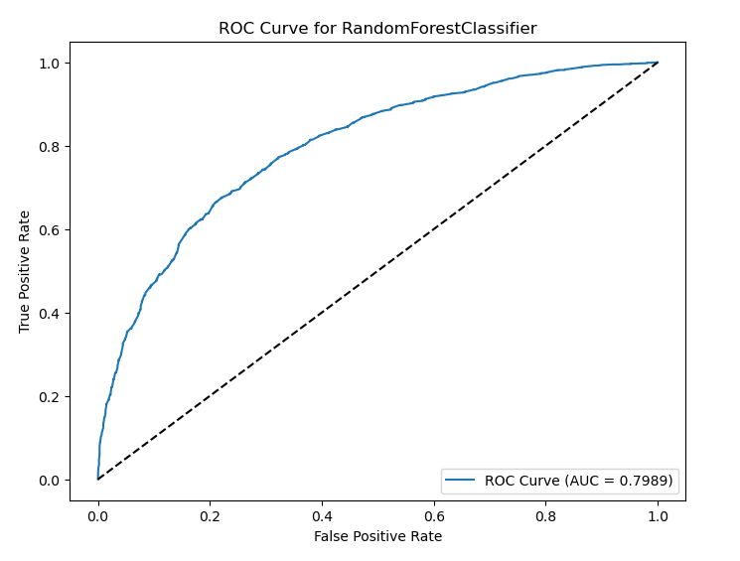
Random Forest

Slide 25
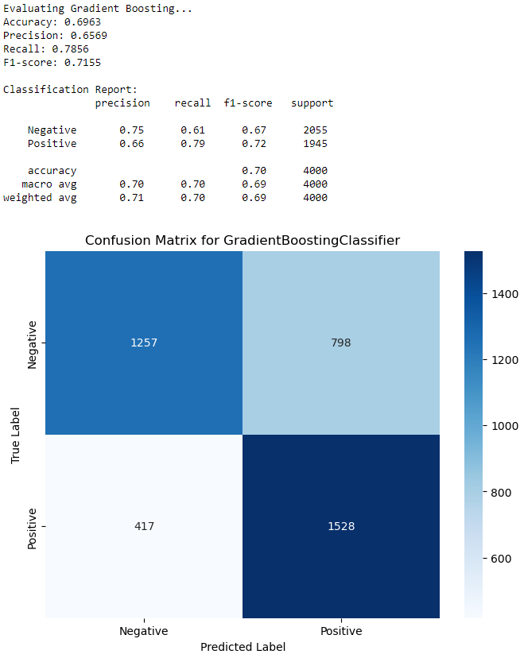
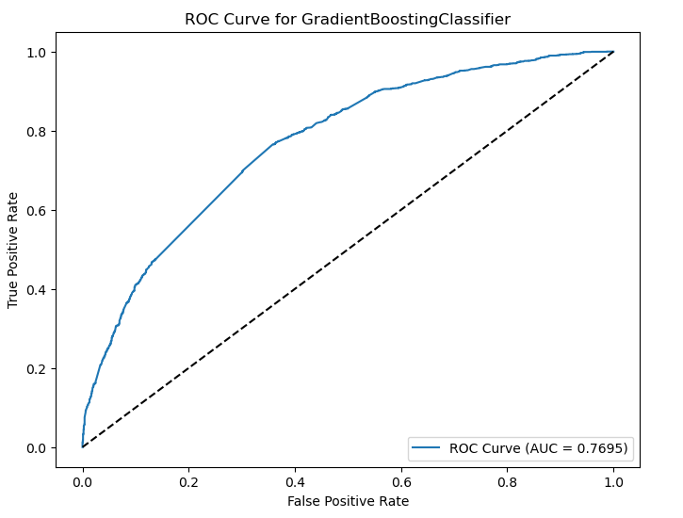
Gradient boosting

Slide 26
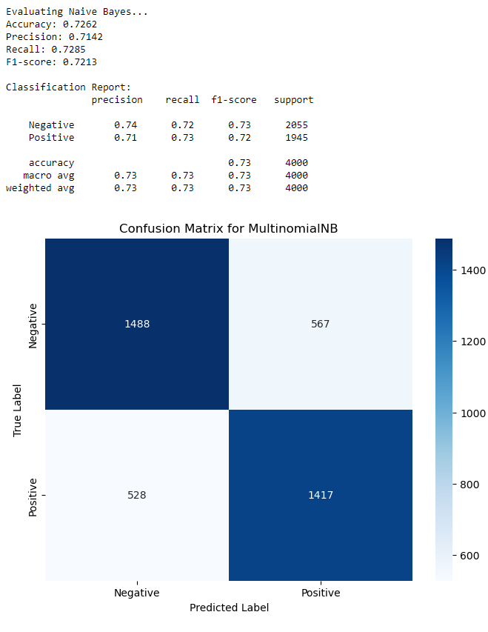
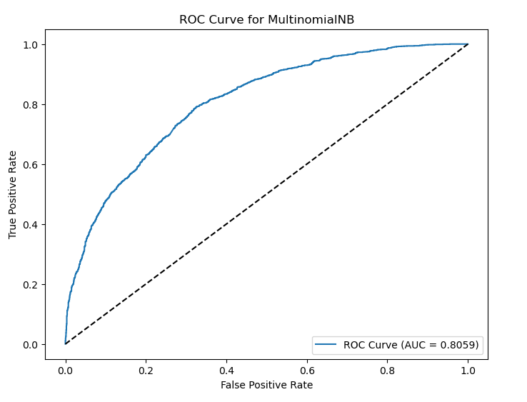
MULTINOMIAL Naïve-Bayes

Slide 27
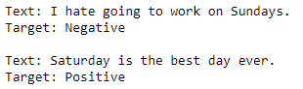
Input new values
Defined a new function labeled 'predict_new_input'
Preprocess the input text
Transform the text using TF-IDF vectorizer
Predict the text using the Machine Learning model
Output the sentiment (Positive/Negative)
Testing the reliability with the following sentences
"I hate going to work on Sundays."
"Saturday is the best day ever."
What about contradictory statements?
"I can't believe how great this product is at being useless."

Slide 28




Contradictory Statements?
Support Vector Machine
Gradient Boosting Classifier
Accuracy = 0.739
Accuracy = 0.696

Slide 29
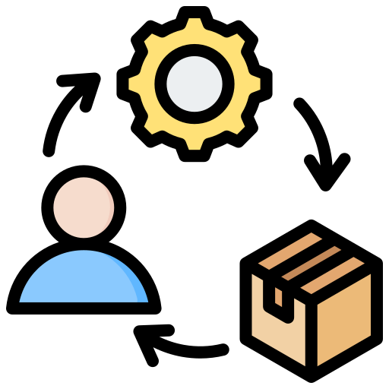

Business Recommendations
Targeted Marketing
Product Development
Implement personalized campaigns for distinct customer segments
Focus on personalized campaigns for Purple Cluster due to their specific and distinct characteristics
Develop features and products tailored to the unique needs of each customer segment.
Use feedback from Clusters 1 and 2 to refine existing products and innovate new ones.

Slide 30


Areas of improvement
Customer Engagement
Feedback Collection
Enhanced customer engagement strategies based on the 4 cluster characteristics
Yellow cluster is too volatile, develop engagement strategies tailored to them
Improve the methods of collecting and analyzing feedback
Implement a more detailed feedback survey/questionnaire for more actionable insights

Slide 31
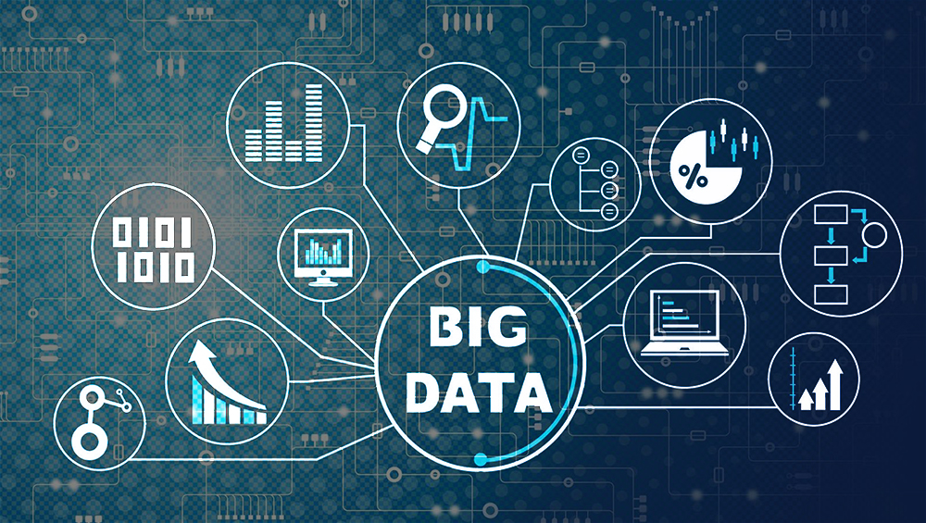

Limitations and better analysis
Data Limitations
Additional Data Required
The dataset is outdated
May not capture all relevant customer sentiments and behaviours
Implement other social media platforms, such as Facebook, Instagram and TikTok
Data such as Comments, Reviews and/or purchase history

Slide 32

Assumptions made
PCA components accurately represent customer sentiments and behaviour
Identified clusters are stable and consistent over time

Slide 33
Thank You!
~Ahmad Harith

